Slide 1
Gigabit Ethernet

Slide 2
Gigabit Ethernet
Ethernet overview
  Ethernet networks are widely deployed: 95% of today’s LANs use Ethernet
  Ever-increasing transmission rate
    1980: 10 Mbps (original Ethernet)
    1995: 100 Mbps IEEE 802.3u (Fast Ethernet) reusing physical signaling methods previously developed & standardized for FDDI
    1998: 1000 Mbps/1 Gbps IEEE 802.3z (Gigabit Ethernet, GbE)
    2002: 10 Gbps IEEE 802.3ae (10GbE) is currently fastest Ethernet standard
    2006: IEEE 802.3 Higher Speed Study Group (HSSG) was formed with the goal to provide standard for 100GbE by the end of 2009
  Costs
    10GbE equipment costs about 80% lower than SONET equipment
    10GbE services will be priced 30-60% lower than other managed network services

Slide 3
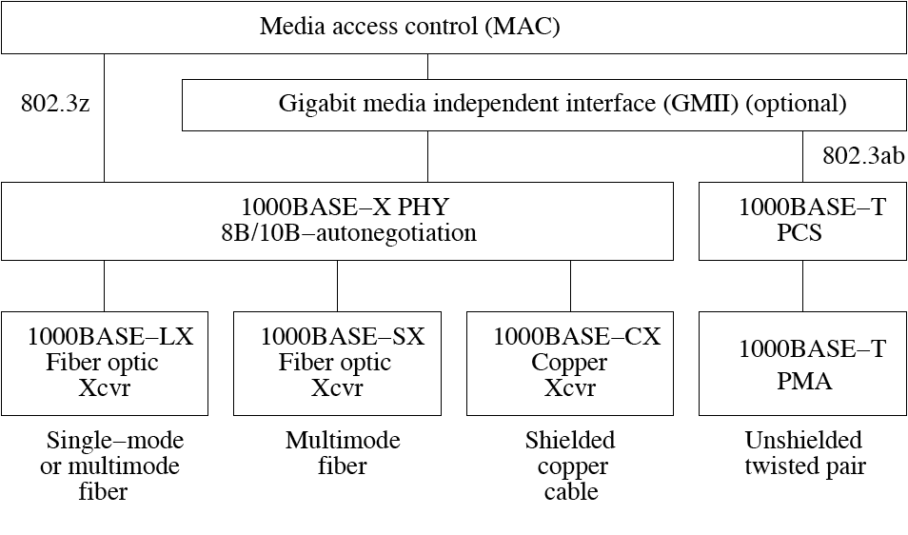
Gigabit Ethernet
Gigabit Ethernet (GbE)
  IEEE standard 802.3z specifies MAC & PHY layers

Slide 4
Gigabit Ethernet
MAC layer
  GbE supports two types of media access
    Shared access (half-duplex mode)
    Dedicated access (full-duplex mode)

Slide 5
Gigabit Ethernet
Shared access (half-duplex mode)
  All stations share Ethernet medium
  Access governed by legacy CSMA/CD protocol
  CSMA/CD protocol enables half-duplex communication
  802.3z extends original CSMA/CD with two enhancements
    Carrier extension
    Frame bursting (optional)

Slide 6
Gigabit Ethernet
Carrier extension
  Collision detection algorithm of original CSMA/CD protocol mandates that round-trip propagation delay between any pair of stations must not exceed transmission time of smallest frame of size 512 bits (64 bytes)
  To increase diameter of GbE networks, minimum frame size is extended from 512 bits to 512 bytes
  Carrier extension
    Set of special symbols appended to end of frames smaller than 512 bytes => extended frames of at least 512 bytes
    Frames longer than 512 bytes are not extended
    Backward compatible with 10 Mbps & 100 Mbps Ethernet networks
    Decreased bandwidth efficiency for small frames => frame bursting

Slide 7
Gigabit Ethernet
Frame bursting
  Optional feature to improve bandwidth efficiency & throughput of GbE networks in half-duplex mode
  Frame bursting
    Enables stations to transmit multiple frames back to back
    First transmitted frame is extended by means of carrier extension
    Transmitting station may send further frames without carrier extension up to a burstLimit of 8192 bytes
    Frame bursting allows station to transmit multiple short frames without carrier extension for all frames but the first one => increased bandwidth efficiency & throughput

Slide 8
Gigabit Ethernet
Dedicated access (full-duplex mode)
  With dedicated access
    CSMA/CD protocol together with carrier extension & frame bursting are disabled
    Network operates in full-duplex mode
  Full-duplex mode
    Previously specified in IEEE 802.3x standard & widely deployed in switched Ethernet LANs since early 1990s
    Lower implementational complexity than half-duplex CSMA/CD-based mode => vast majority of commercial GbE equipment operates in full-duplex mode
    Increased aggregate network throughput of 2 Gbps
    No round-trip delay constraint => network links of arbitrary length subject to physical transmission impairment limits
    So-called pause protocol enables link-level flow control between two adjacent stations connected by point-to-point link without intermediate bridges, switches, or routers

Slide 9
Gigabit Ethernet
GMII
  Ethernet has always been using media-independent interface (MII) to let MAC layer interoperate with variety of different physical media
  GbE’s optional Gigabit MII (GMII) provides means to develop further physical media & attach them to MAC layer (e.g., Category 5 UTP cabling, aka 1000BASE-T)
  IEEE standard 802.3ab specifies GbE transmission over widely installed Category 5 UTP cabling

Slide 10
Gigabit Ethernet
PHY layer
  PHY layer converts data from MAC layer into optical or electrical signal & transmits it across physical medium
  GbE PHY layer subdivided into
    Physical coding sublayer (PCS)
      Uses 8B/10B encoding of ANSI Fibre Channel standard
      Encapsulates MAC data frames, including 32-bit CRC
    Physical medium attachment (PMA)
      Transmits 10-bit code groups serially by means of NRZ line coding at 1.25 Gbps
  PCS & PMA together with autonegotiation protocol are collectively referred to as 1000BASE-X PHY
    Autonegotiation protocol
      Used for link initialization & configuration
      In Fast Ethernet used to select between 10 & 100 Mbps
      In GbE used to select duplex mode & pause protocol

Slide 11
Gigabit Ethernet
Physical media
  GbE runs over
    Optical fiber pair for transmission & reception
      1000BASE-LX
        LX transceiver works on single-mode & multimode fibers
        Intended for longer distances
      1000BASE-SX
        SX transceiver works only on multimode fiber
        Targets short-distance applications
    Shielded copper cable
      1000BASE-CX
        Economic choice for short-distance interconnections
    UTP cable
      1000BASE-T
        Operates on four pairs of Category 5 UTP cables

Slide 12
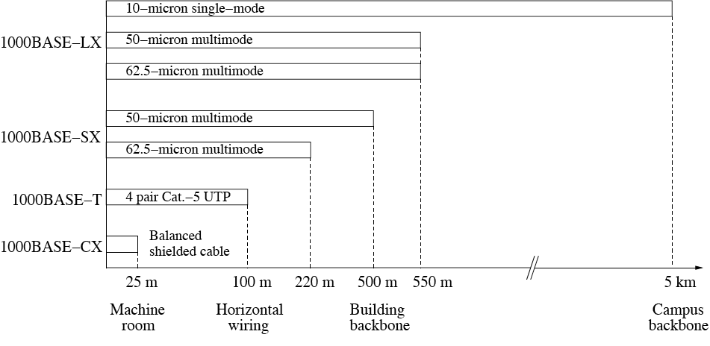
Gigabit Ethernet
Link distances

Slide 13
Gigabit Ethernet
10GbE
  Operates only over fiber & in full-duplex mode
  Provides interoperability not only with Ethernet but also with SONET/SDH => end-to-end Ethernet networks
  Support of seven port types
    Four LAN PHY ports
      Three ports deploy bit-serial transmission across single- or multimode fibers
        64B/66B encoding
      One port sends data across four CWDM wavelengths
        Wide wavelength division multiplexing (WWDM)
        8B/10B encoding on each wavelength
    Three WAN PHY ports
      Bit-serial transmission across single- or multimode fibers
      Dynamically increased interframe spacing to match slightly lower than 10 Gbps data rate of OC-192 SONET/SDH

